Slide 1
JEDI Project Presentation
On
FlipFit Gym Application
GROUP - F

Slide 2
The Ask – Where we started?
Beginners in software development, aiming to enhance our skills in UML, Java, MySQL, and web integration for real-world applications.

Slide 3
Framework for 6 Days
6 Days plan.
Every Day Discussion about Topics/ Technologies/ Doubt clearance.
Everyday with SME/Trainer discussion of Project progress & Transformation based on UML & Technologies.

Slide 4
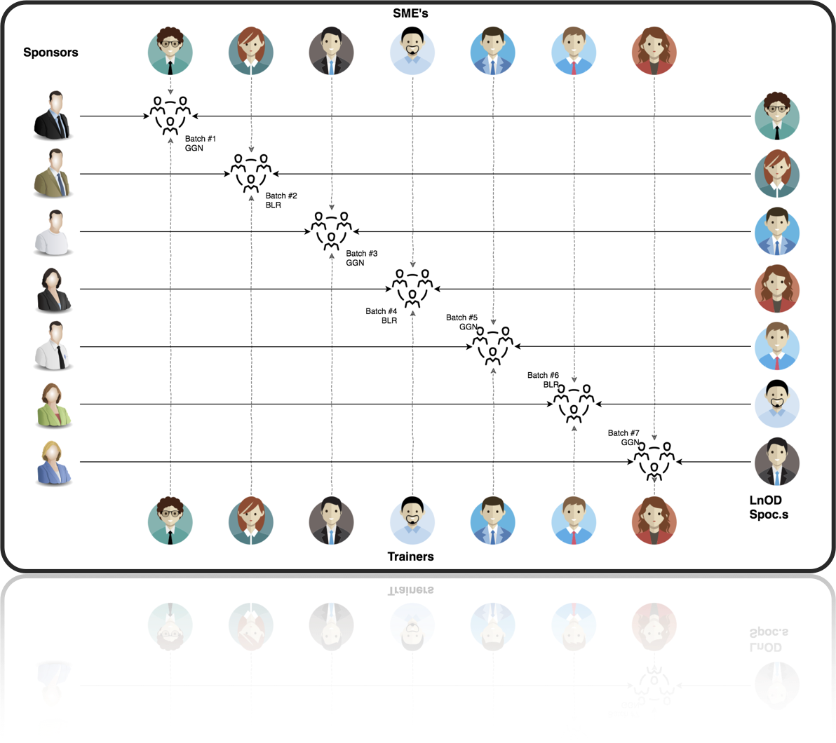
Stakeholders
Sponsors
Flipkart
SME’s
Amit Balyan
Other HRs and Experts
Anushka Khanna
Chaitra Harti

Slide 5
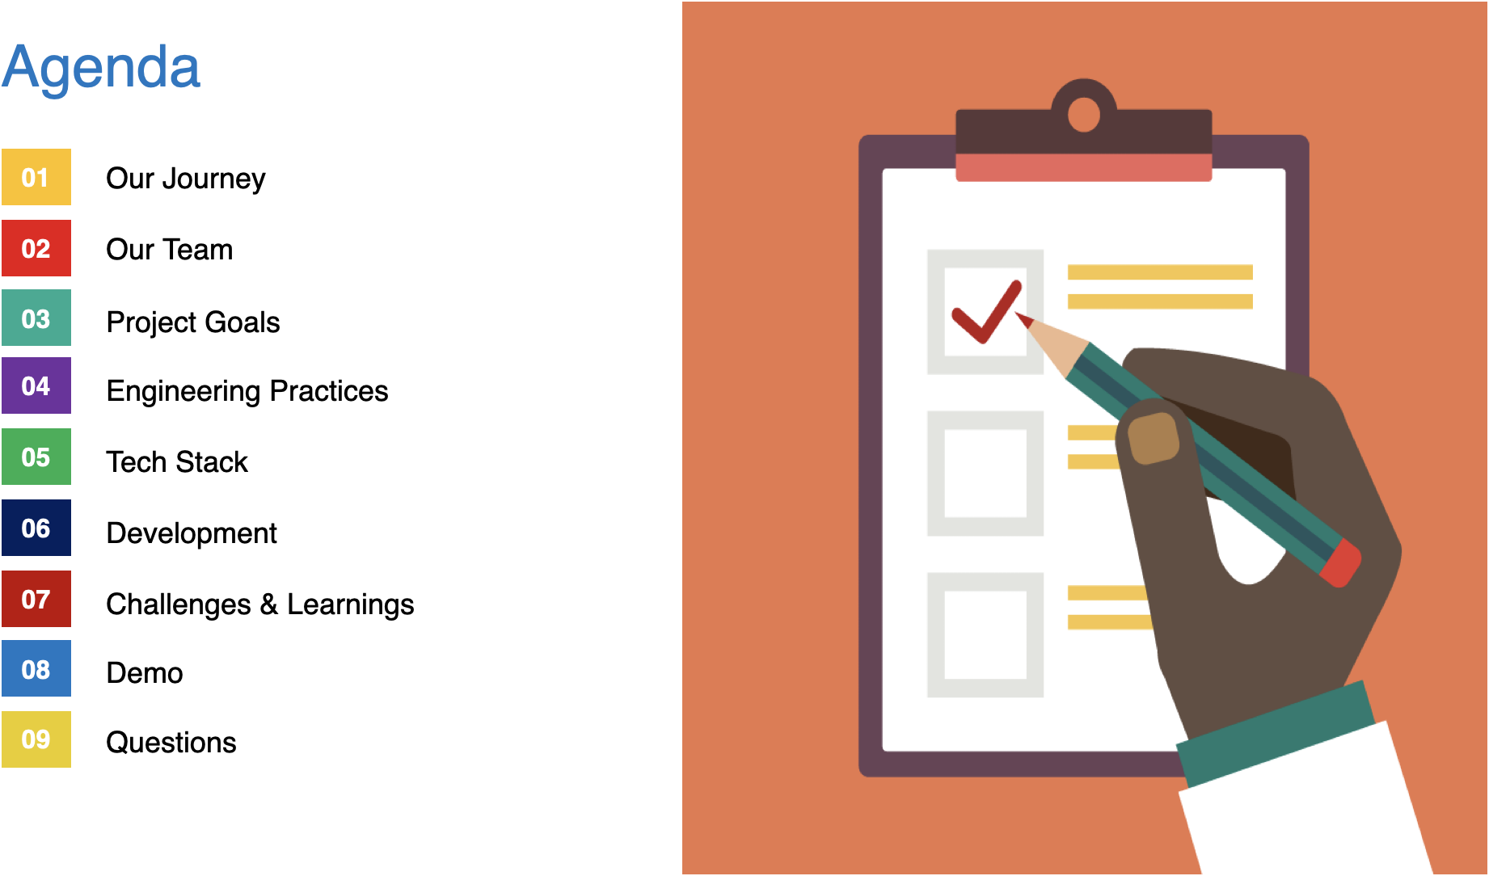

Slide 6

Our Team
Sanskruti Shahu
Pallavi Dhakne
Aman Mittal
Lakshmi Priyanka
Sakshi More
Shruti Kumari
Archana Kumari
Tusharika Maheshwari
Vuddagiri Tejo Manasa
Muhammad Zaid

Slide 7

Our Journey

Slide 8
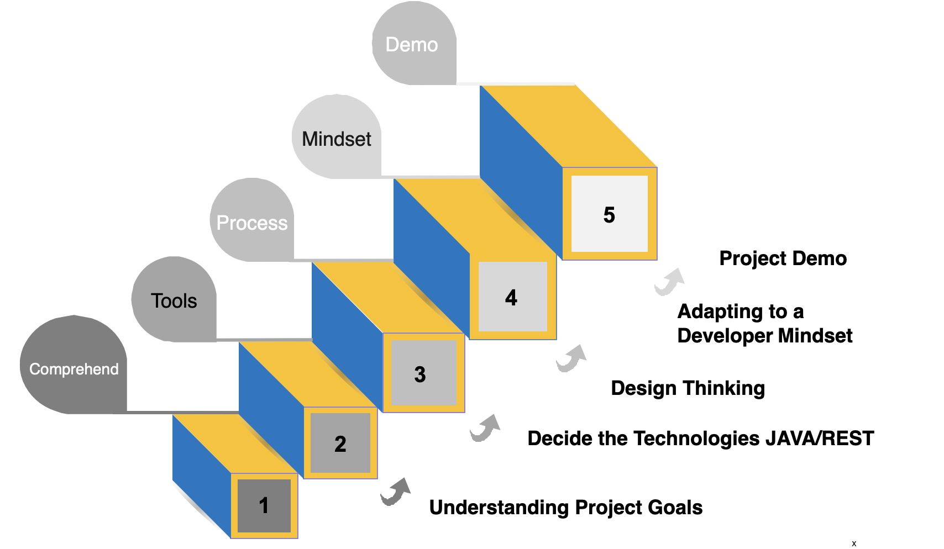

Slide 9
Project Goals
To develop a comprehensive FlipFit Gym Management System using full-stack development tools and technologies, enabling both agents and customers to seamlessly manage and access various gym services and product.
This FlipFit Application helps the users to view all the gym centres that are available for the given city thereby choosing their feasible centre and a slot of their desired choice by checking the availability of it.

Slide 10
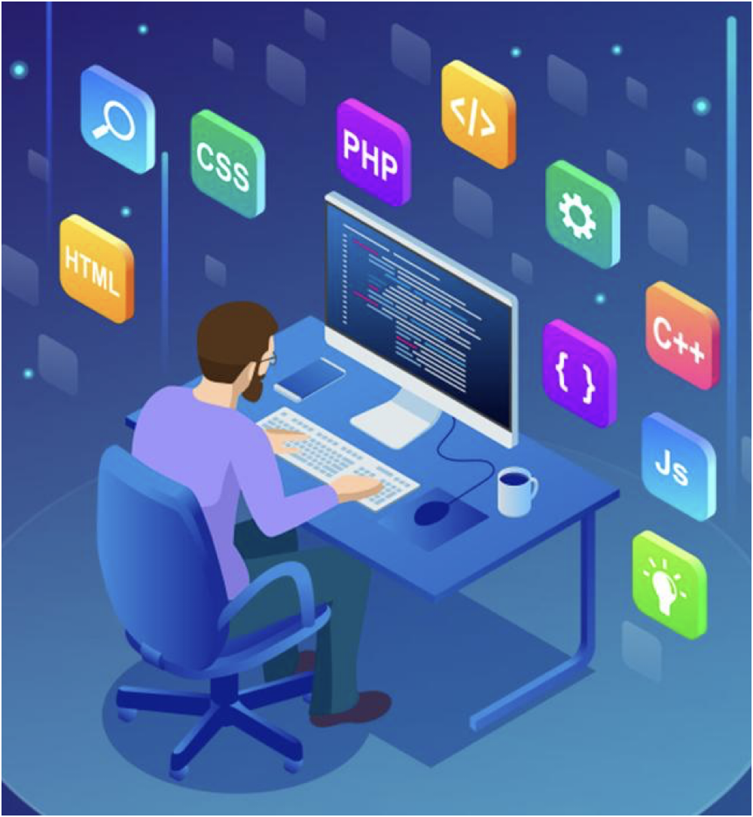
Tech Stacks

Slide 11
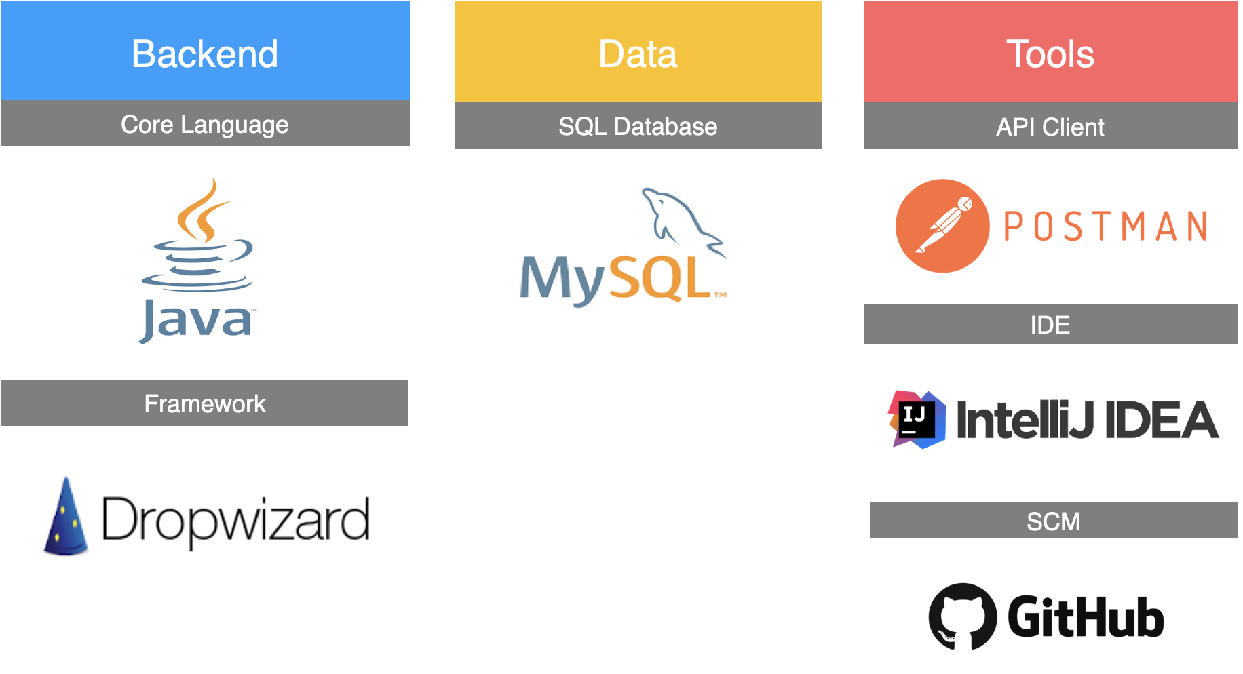


Slide 12
Our Approach
Introduction and discussion about the previous skills and trainings of each individual.
Brief overview of the project and the tech stacks being used along with installation of the softwares.
Every day discussion on each part of project to be included and the role of that part in the entire application
Creation of the model diagrams -Use Case Diagram, Class Diagram, Activity Diagram
Changes introduced in the application according to the arising needs and further implementation.
Everyday with SME/Trainer discussion of Project progress & Transformation based on UML & Technologies .

Slide 13
Development
FlipFit aims to address the following key objectives:
Streamlined Booking Experience: Simplify the process of booking gym slots across multiple centers in Bangalore through a user-friendly interface.
Optimized Resource Management: Efficiently manage gym resources such as available slots, equipment, and user capacities to ensure a smooth user experience.
Enhanced Partner Engagement: Foster strong partnerships with gyms by providing them with a robust platform to manage bookings, monitor attendance, and optimize resource utilization.
Customer Satisfaction: Improve customer satisfaction by offering transparent information on available slots, seamless booking processes, and timely notifications.

Slide 14
Features of FlipFit Application
Different Gym owners from different centres can register their gyms on the app and smoothly run their business.
Users can check the slots available in various gyms and choose according to their time, region and affordability.
The credibility of the gyms are managed by the admin by approving verifying and approving the gym owners’ details.
Booking of Slots in a Gym according to users convenience and availability in gyms.
Users can cancel their booking and book another slot in case they miss the slot.
Use of Databases for storing information about centers and booking. No in-memory storages
Customers can view his/her plan basis day as input.
Once the seats get filled up, there is a waiting list. Also waitlisted candidates get their slots booked when there is vacant slot.

Slide 15
Project Structure
Beans: Initialisation of classes and their setter and getters- Used for schema and row mapping in JDBC.
Client: Added controller/frontend logic code which works in command line terminal. It acts as the entry point of FlipFit application
Business: Working logic of the FlipFit features in the backend.
DAO: Storing and retrieving of data from MYSQL database using queries.
Exceptions: Custom exceptions designed to handle missing data or invalid credentials.
Constants: Contains the mysql queries as constants which can be used in DAO layer thus increasing code reusability
Sql schema: Contains the schema of the tables in database.

Slide 16
Challenges Faced
Getting adapted to the new tech stacks.
Installation of new softwares and adapting to work with them.
Integration of different modules of project.
Coordination and Communication among teammates while working remotely through version control system.
Testing and debugging of the code according to changes in schema of database.

Slide 17
Learnings
Team Collaboration and Effective Communication.
Tech Stack: Git, Github, Java, MySQL.
Developing a fully working application along with scope of scalability at every stage.
Handling the coupling and interdependence of modules while working of a large level project.
Industrial Development Practices and working under deadline.

Slide 18
Learnings
Continuous change in code and its deployment to GitHub using git commands.
Use of recent version of JAVA and APIs like Date and Time and Stream API for enhancing the efficiency of application.
Learnt the need of use case diagrams, class diagrams, activity diagram before starting the project.
Understood the need of proper commenting of code and documentation while working on a project that is being completed in stages.

Slide 19
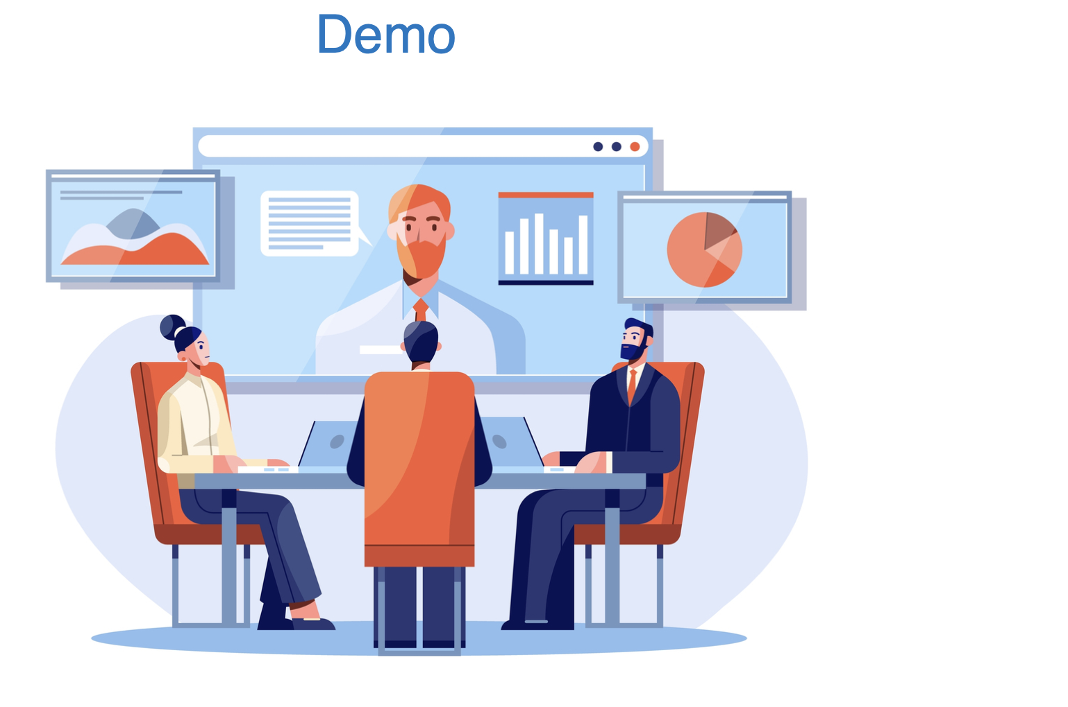

Slide 20

Q&A

Slide 21
Thank you!!

